Slide 1
OLA : Case Study Analysis
A SEMINAR REPORT
Submitted by
Manoj H. Yadav
in partial fulfillment for the award of the degree
of
M.Sc. Data Science and Artificial intelligence
RAMNIRANJAN JHUNJHUNWALA COLLEGE OF ART’S, SCIENCE & COMMERCE (AUTONOMOUS), GHATKOPAR (W)
March 2021

Slide 2
Table of contents
Chapter No. | Title |  | Page No.
i | About |  | i
ii | Ola cabs Business plan |  | ii – v
 | a | Funding by Investors
 | b | Marketing Strategy
 | c | Services
iii | Challenges faced by Ola cabs |  | ix
 | a | Technology | ix
 | b | Overcharging and lack of transparency | ix
iv | The successive factor of ola cabs |  | vii
v | Result |  | viii

Slide 3
Abstract
"Start-ups don't die, they commit suicide. In other words, 90 percent of start-ups fail because the founders get bored, discouraged, or something else, and they move on to other things, not because of some catastrophe. No matter how dark it is today, things will always better tomorrow." -- Justin Kan, Justin.TV.
Startup businesses have always played an important role in the global economy, but recently their importance has grown significantly. For this reason, governments around the world have amended regulation and created incentives to encourage their development. However, statistics shows that startups have an extremely high mortality rate, often due to a lack of strategic planning, wrong marketing investments or inefficient resource allocation. This is the success story of an Indian startup, Ola Cabs. As the competition in the Radio Taxi market is increasing at a very faster rate where several brands are providing cabs to the customers as per the requirements, this paper is designed to study the success story of Ola cabs which has the greatest market share and provides services in an efficient manner along with customer satisfaction. The Marketing strategy and promotion strategy adopted by Ola Cabs is discussed briefly in this case study.

Slide 4
About:
Ola Cabs is an Indian ridesharing firm that provides services including peer-to-peer ridesharing, ride-hailing, taxi, and food delivery.
The company was founded by ANI Technologies Pvt and is headquartered in Bengaluru, Karnataka, India Ltd.
Ola had been valued at about $10 billion as of October 2019,
Founded on: Mumbai 3 December 2010.
Chief executive: Bhavish Aggarwal (3 Dec 2010 )
Adequate staff companies: Foodpanda India; Ola Electrical Mobility
Headquarters: Bengaluru
Revenue: INR 2,222 crores (2018)
Founders: Ankit Bhati , Bhavish Aggarwal.

Slide 5
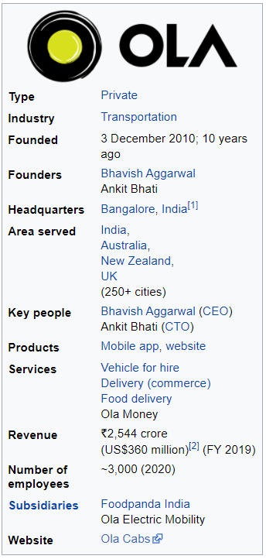

Slide 6
Ola Cabs Business Plan:
FUNDING by INVESTORS:
In March 2015, Ola Cabs acquired Bengaluru-based taxi service TaxiForSure for approximately ₹ 1237 crore (US$ 200 million).June 2015 onwards, Ola users gained access to TFS cabs via the Ola mobile application. Later in the year in November, Ola further acquired Geotagg, a trip-planning applications company, for an undisclosed sum.
In a move to expand beyond cab aggregation, Ola acquired struggling foodtech company Foodpanda with an eye on leveraging the growing food delivery segment business in December 2017.
In April 2018, Ola made its second acquisition with Ridlr (formerly Traffline), a public transport ticketing app. Later in August 2018, Ola financed Series A funding of the scooter rent startup Vogo, and again in December, invested another $100 million.
In February 2019, Ola split off its electric car business into a new company called Ola Electric Mobility with US$ 56 million in investment money. Tiger Global and Matrix India contributed to the funding
In addition to electric cars, Ola Electric is also focusing on charging technologies, EV batteries, and building feasible infrastructure to allow commercial EVs to run on a scale. On 6 May 2019, the company revealed that Ratan Tata has invested an undisclosed sum in Ola Electric as part of its Series A funding round.
Ola Electric earned SoftBank $250 million during the Series B round of investment in July 2019, gaining more than $1 billion in interest.

Slide 7
2. Marketing strategy:
STRATEGIC PARTNERSHIP WITH MAKE MY TRIP: la cabs started their partnership with making my trip in the year 2013. Under this partnership, my trip customers would receive rental car facilities to pick up and drop off at the desired destination. This move by Ola helped to gain a large base of customers as people became more aware of the brand.
ADVERTISING PARTNERSHIP WITH TVF: Ola created a partnership with the Indian online web series platform TVF (The Viral Fever). TVF has a strong fan base and Ola has tried to exploit that situation. Ola gets customers from the existing fan base of TVs while on the other hand even TVF gets to reach customers of Ola.
Financial STRATEGY: Ola focuses on consumer marketing by segregating its fleet into different versions that are appropriate for customer demand and that also suits their budget.
SOCIAL MEDIA: These are other advertising tools used by Ola to promote the product on the market. Ola cabs used platforms such as banner advertising, newspaper advertisements, broad-scale tv ads as well as Facebook’s online media site, twitter as part of their initiative.

Slide 8
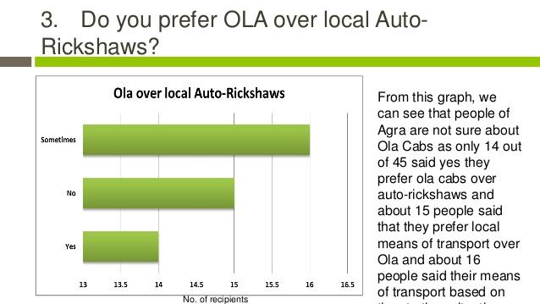
3.Services
Ola offers different levels of service, ranging from economic to luxury travel.
The cabs are reserved through a mobile app and also through their website and the service accepts both cash and cashless payments with Ola money.
It claims to clock an average of more than 150,000 bookings per day and commands 60% of the market share in India as of 2014.
Anand Shah, co-founder, Ola Electric and senior VP, Ola Cabs said that Ola Electric will need more capital to achieve its target of putting 1 million EVs on the roads by 2021.
Ola Electric acquired Amsterdam-based EV startup Etergo on 27 May 2020 to launch an own line of electric scooters in 2020.

Slide 9
Challenges faced by Ola Cabs:
Technology
Ola Cabs' technology came under criticism regarding the security of its mobile app.
In August 2016, a privacy breach occurred when customers' details such as names, phone numbers and addresses.
On January 19, 2020, a technical glitch caused multiple users to receive notifications such as "Your ride is on the way" or "Your ride is here" despite them not even attempting to book through the platform.
Overcharging and lack of transparency in charging
On January 2021, Telengana State Taxi and Drivers Joint Action Committee has requested transport authorities to look into allegations of fare manipulation by Ola and Uber.

Slide 10
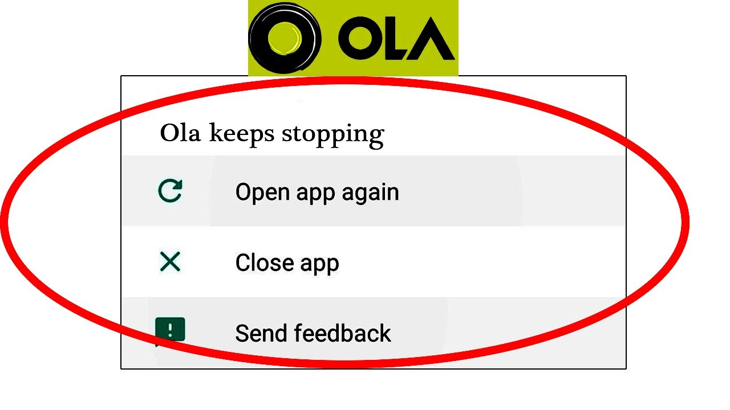
Here some other issues faces by Ola:-
Competition growing
Security of women.
Competitor activity at the regional level.
Dropping into the wrong places.
Driver behavioral issues.

Slide 11
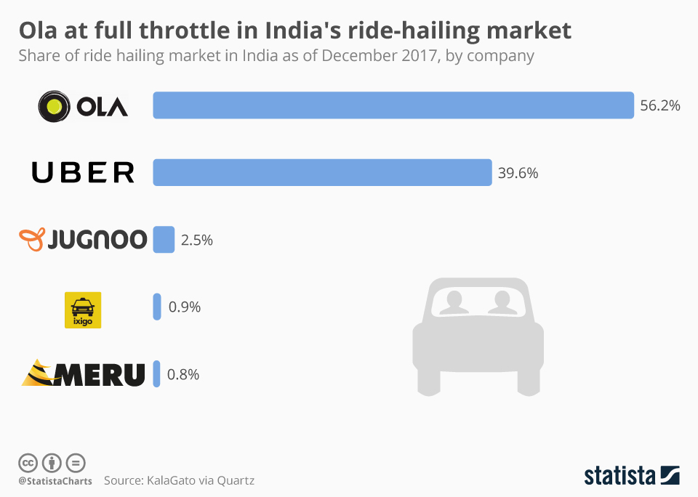
The successive factor of Ola Cabs:
Ola is the first of its kind taxi aggregator service provider in the country.
It achieved the no.1 rank in the sector after acquiring Taxi for sure.
The services offered by ola are well appreciated by the public.
TV, online, and print media marketing has helped to create awareness about the company.
Increase in customer base due to strong network effect.
The financial condition of the company has improved after investments from various firms.

Slide 12
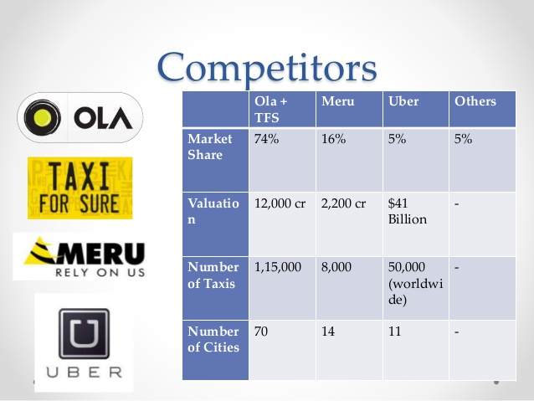
Result:
In the taxi market sector, Ola has seen tremendous growth. There is no going back for Ola when every prospect grows day by day.
Ola‘s revenue has increased over the past four years by nearly 10 folds. Today, it’s the country’s biggest taxi service provider.
The main factor in making Ola a profitable brand is the company’s reliable and easy accessibility.

Slide 13
Reference
https://en.wikipedia.org/wiki/Ola_Cabs
https://www.olacabs.com

